Slide 1

CHRISTMAS SHOEBOX APPEAL
SECONDARY SCHOOL PRESENTATION

Slide 2
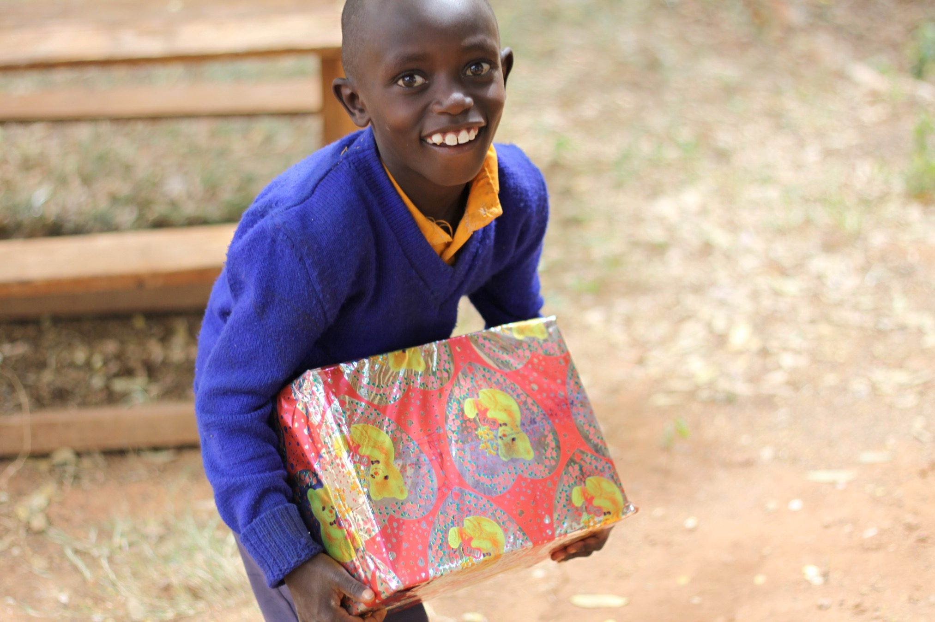
MAIN HEADING
GOES HERE

Slide 3

CHRISTMAS SHOEBOX APPEAL
Every year people in Ireland send Christmas Shoebox gifts to children affected by poverty.
Christmas Shoeboxes are gifts that help to bring joy to children and they also give things that they need like copy book and pencils for school and warm clothes.
MAIN HEADING
GOES HERE

Slide 4
CHRISTMAS SHOEBOX APPEAL
Poverty is where a person doesn’t have and can’t get enough money for their basic needs like food, shelter (a home) and education (school). Poverty can be caused by wars, climate change, people not having enough rights and inequality.
MAIN HEADING
GOES HERE

Slide 5
CHRISTMAS SHOEBOX APPEAL
Through our Christmas Shoebox Appeal we recognised many struggles faced by the communities we visited. With this knowledge, we have been able to work with our partners to help in the most needed ways in each country.
MAIN HEADING
GOES HERE

Slide 6
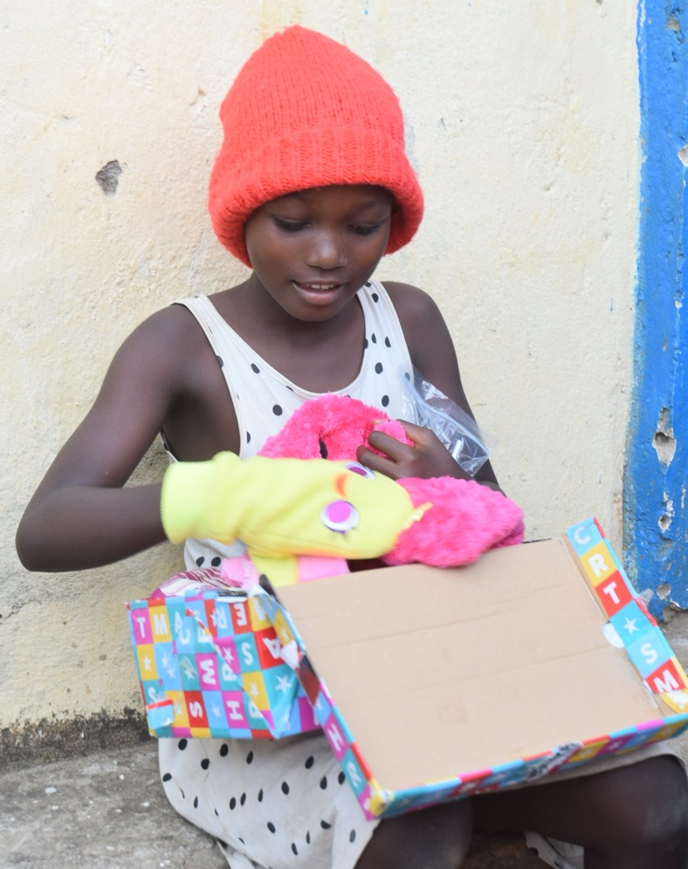
Aliona in Burundi
Aliona was delighted to get so many toys and copybooks!
“My parents will not struggle too much to get enough copybooks as they are too expensive!”
MAIN HEADING
GOES HERE

Slide 7
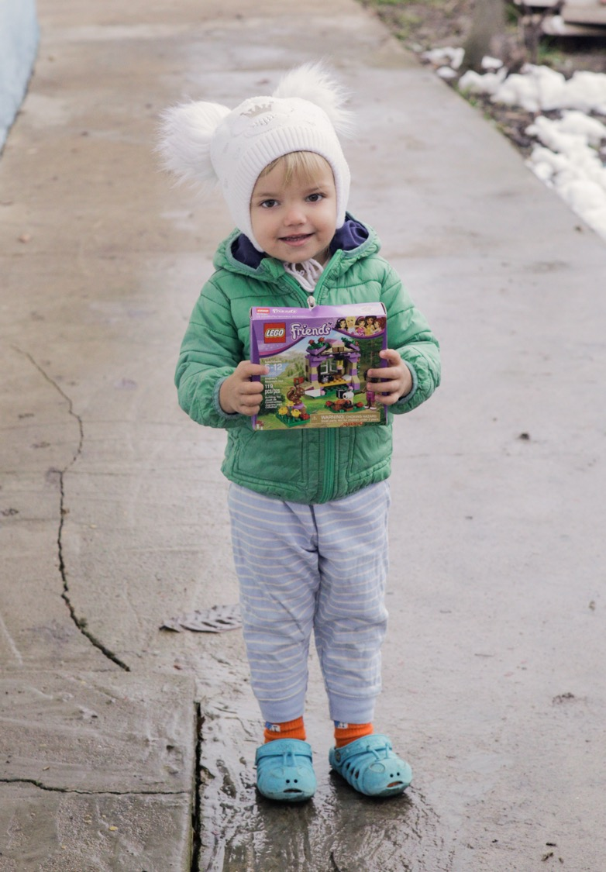
Eva in Transnistria
Eva lives with her mum Sasha. Team Hope’s partners brought Sasha and Eva firewood and food as well as a Christmas Shoebox for Eva. She was thrilled and loved the lego and little handbag- it was like a dream come true for her.
MAIN HEADING
GOES HERE

Slide 8
CHRISTMAS SHOEBOX APPEAL
Let’s break the record
Get your school & community involved
Be the change you want to see
MAIN HEADING
GOES HERE
Notes:
This year we want to send a record number of shoeboxes to children and we need your help!
You can get your whole class, whole school or whole community involved!

Slide 9
CHRISTMAS SHOEBOX APPEAL
Keep count of how many Christmas Shoeboxes your school has made to show everyone how well they’re doing!
Fundraise to build more Shoeboxes!
Follow us on Instagram & let us know how you’re getting on!
MAIN HEADING
GOES HERE

Slide 10
How to make a Christmas Shoebox
Get a shoebox!
Wrap it
Put in the presents
Add €5
Drop it off at school / your local drop off point
MAIN HEADING
GOES HERE

Slide 11
What to put in your Christmas Shoebox
WRITE: Some things to write with
WASH: Some things to wash with
WEAR: Some things to wash with
WOW! Some things to make a child say ‘wow’!
€5 (or give this online at TeamHope.ie)
MAIN HEADING
GOES HERE

Slide 12

Some things to WRITE with
MAIN HEADING
GOES HERE

Slide 13
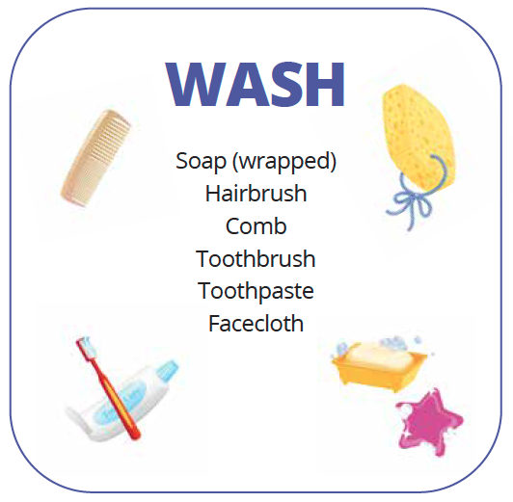
Some things to WASH with
MAIN HEADING
GOES HERE

Slide 14
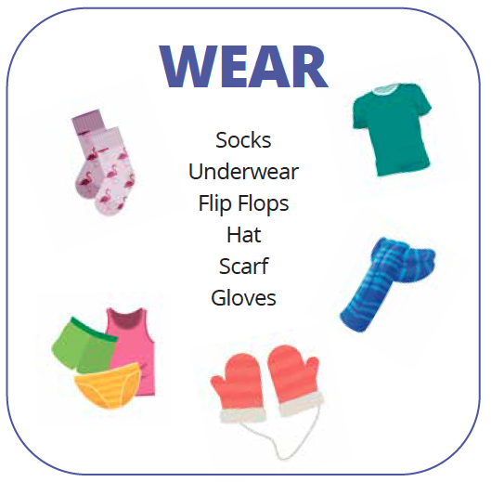
Some things to WEAR
MAIN HEADING
GOES HERE

Slide 15
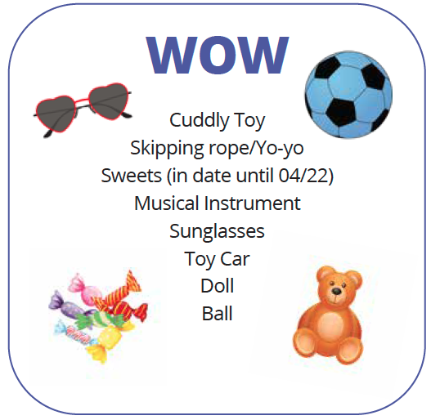
Some things make the child who receives your Christmas Shoebox say WOW!
April next year)
MAIN HEADING
GOES HERE

Slide 16
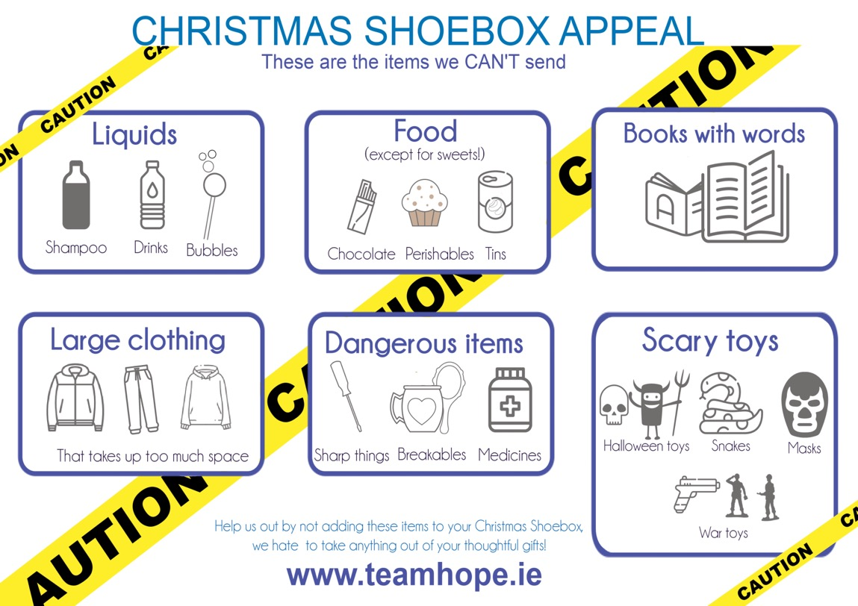
What NOT to put in your Christmas Shoebox
MAIN HEADING
GOES HERE

Slide 17
Your shoebox gift will be given into the hands of a child in need, irrespective of their race, religion, ethnicity or background. The only criteria for receiving a shoebox is the need of the child.
Thank you for making a difference !
MAIN HEADING
GOES HERE

Slide 18


Team Hope’s other projects
Poverty and hunger affect millions of people across the world. Team Hope seeks to provide help to children living in poverty through working with their families and communities to bring lasting
change. We work with communities to
build real change for a brighter future.
MAIN HEADING
GOES HERE

Slide 19

Team Hope’s other projects
Supply clean water
Provide healthcare
Generate income for those living in poverty
Care for those with HIV/AIDS
Provide education
Help communities in need
MAIN HEADING
GOES HERE

Slide 20
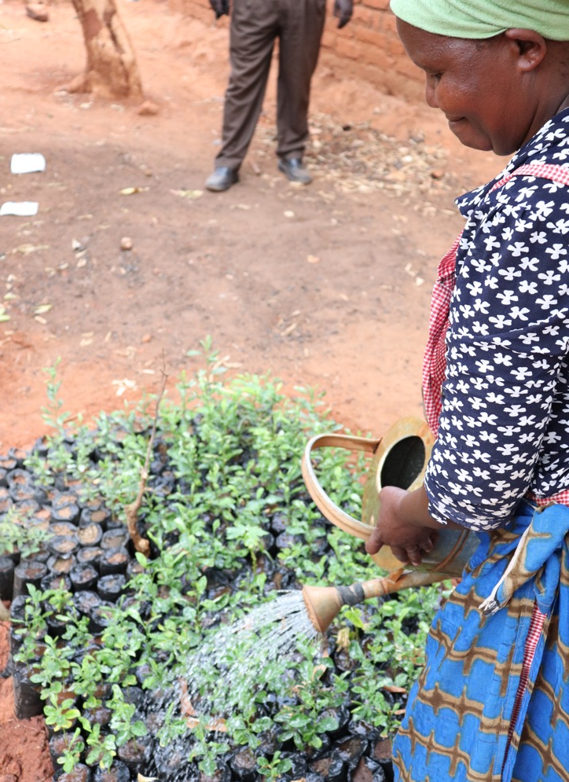
Agnes in Kenya
“Before I got water I had many problems. We tried to cut trees to make charcoal and had to travel far to the towns to sell it,”
“After we got water it has changed my life”
MAIN HEADING
GOES HERE
Notes:
“Before I got water I had many problems. We tried to cut trees to make charcoal and had to travel far to the towns to sell it,” says Agnes. Cutting down trees for charcoal is often a last resort for poor families and damages the environment.

Slide 21
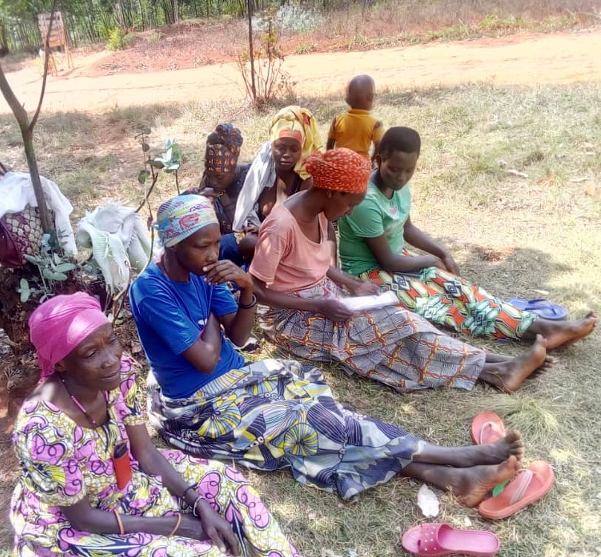
Kella in Burundi
“ I did not know how to do the activity that can give me money. I was only farming and this activity cannot satisfy all the needs in the family. But thanks to the teachings that I have just received, I will participate in the village savings and loan association …and my family’s living conditions will be improved.”
MAIN HEADING
GOES HERE
Notes:
Another woman benefiting from the VSLA is Kella. Kella is also a mother who felt she had no way to make money of her own to support her children.
Nana and Kella were both supporting the basic needs of their families by growing their own food. Because they didn’t own their own land suitable for growing, poverty was a real obstacle and malnutrition a heartbreaking reality.
Last year ARM trained ten groups of three people from different villages and commissioned each group to invite and train twenty seven other people in their villages to join their group.
In a country where the total annual production of food would only cover for 55 days per person per year*, Team Hope’s partners, ARM, have a vision to improve the lives of those in their rural communities. They work year round with women like Nana and Kella and their children, supporting them to overcome poverty.

