Slide 1

CHRISTMAS SHOEBOX APPEAL
PRIMARY SCHOOL PRESENTATION

Slide 2
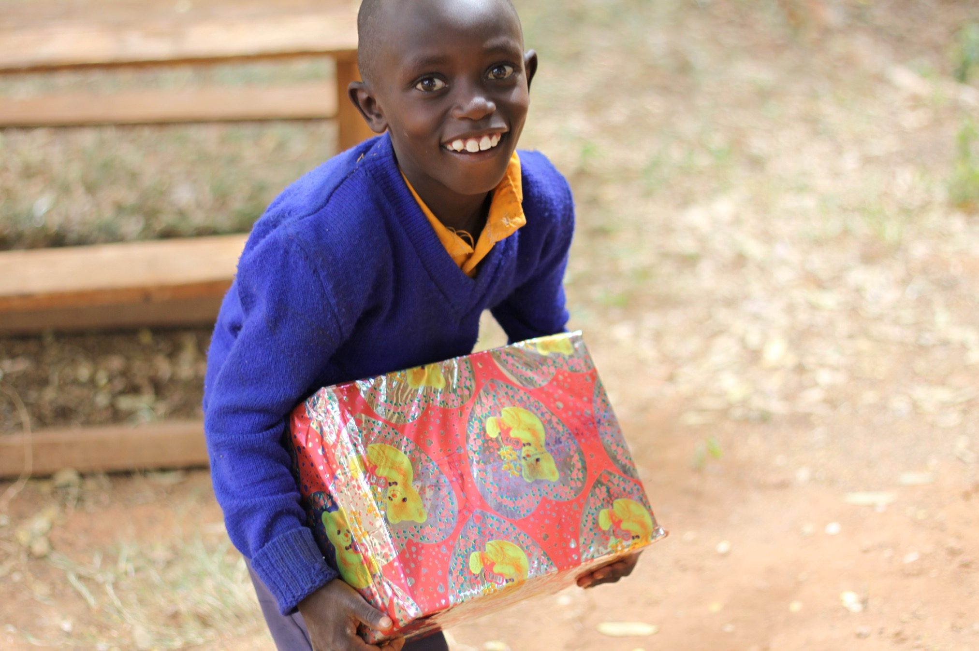
MAIN HEADING
GOES HERE

Slide 3

CHRISTMAS SHOEBOX APPEAL
Every year people in Ireland send Christmas Shoebox gifts to children.
Christmas Shoeboxes are gifts that help to bring joy to children and they also give things that they need like copy book and pencils for school and warm clothes.
MAIN HEADING
GOES HERE

Slide 4
CHRISTMAS SHOEBOX APPEAL
Christmas Shoeboxes are given to children in areas of poverty. Poverty is where a person doesn’t have and can’t get enough money for their basic needs like food, shelter (a home) and education (school). Poverty can be caused by wars, climate change, people not having enough rights and inequality.
MAIN HEADING
GOES HERE

Slide 5
How to make a Christmas Shoebox
Get a shoebox!
Wrap it
Put in the presents
Add €5
Drop it off at school / your local drop off point
MAIN HEADING
GOES HERE

Slide 6
What to put in your Christmas Shoebox
WRITE: Some things to write with
WASH: Some things to wash with
WEAR: Some things to wash with
WOW! Some things to make a child say ‘wow’!
€5 (or give this online at TeamHope.ie)
MAIN HEADING
GOES HERE

Slide 7

Some things to WRITE with
MAIN HEADING
GOES HERE

Slide 8
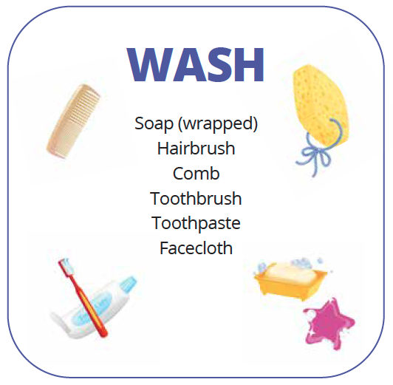
Some things to WASH with
MAIN HEADING
GOES HERE

Slide 9
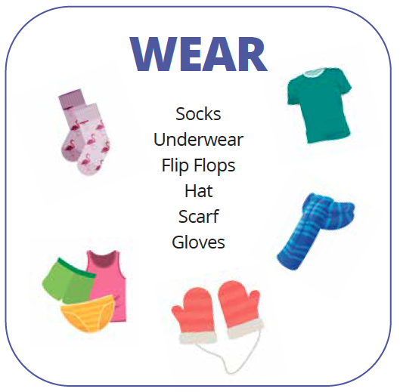
Some things to WEAR
MAIN HEADING
GOES HERE

Slide 10
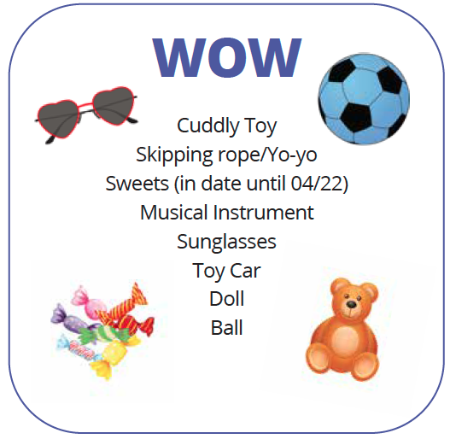
Some things make the child who receives your Christmas Shoebox say WOW!
April next year)
MAIN HEADING
GOES HERE

Slide 11
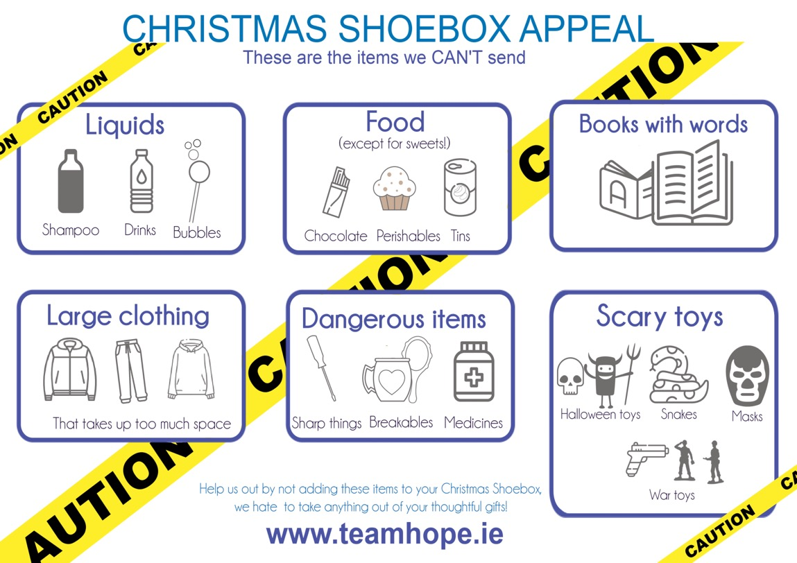
What NOT to put in your Christmas Shoebox
MAIN HEADING
GOES HERE

Slide 12
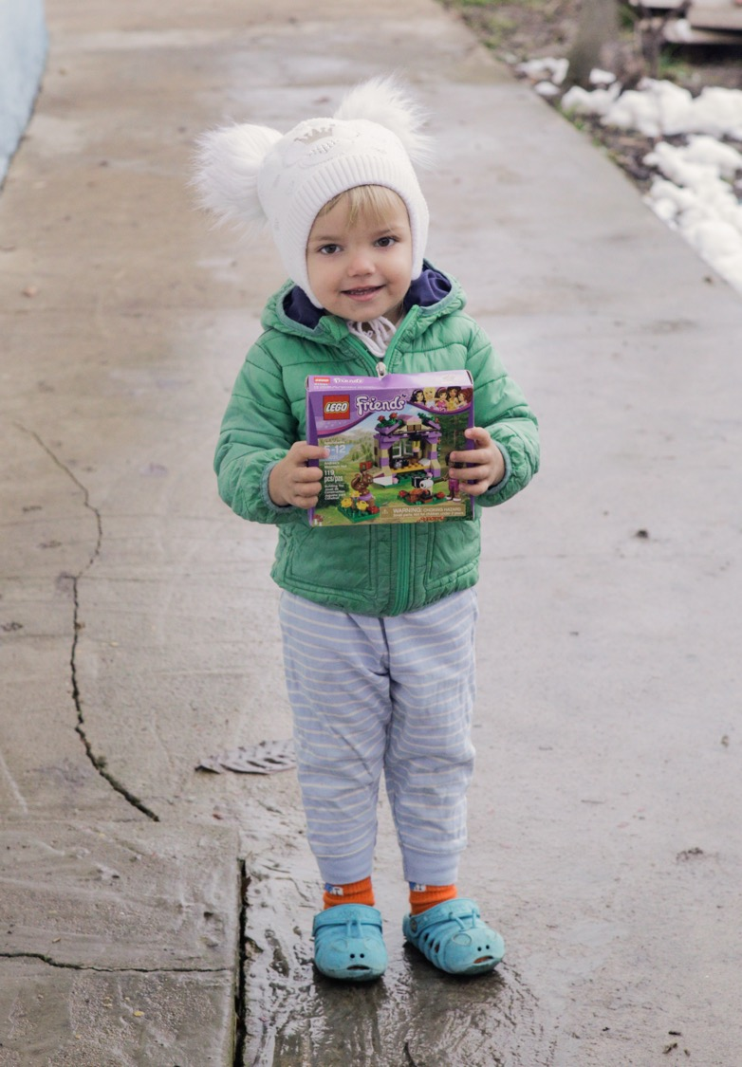
Eva in Transnistria
Eva lives with her mum Sasha. Team Hope’s partners brought Sasha and Eva firewood and food as well as a Christmas Shoebox for Eva. She was thrilled and loved the lego and little handbag- it was like a dream come true for her.
MAIN HEADING
GOES HERE

Slide 13
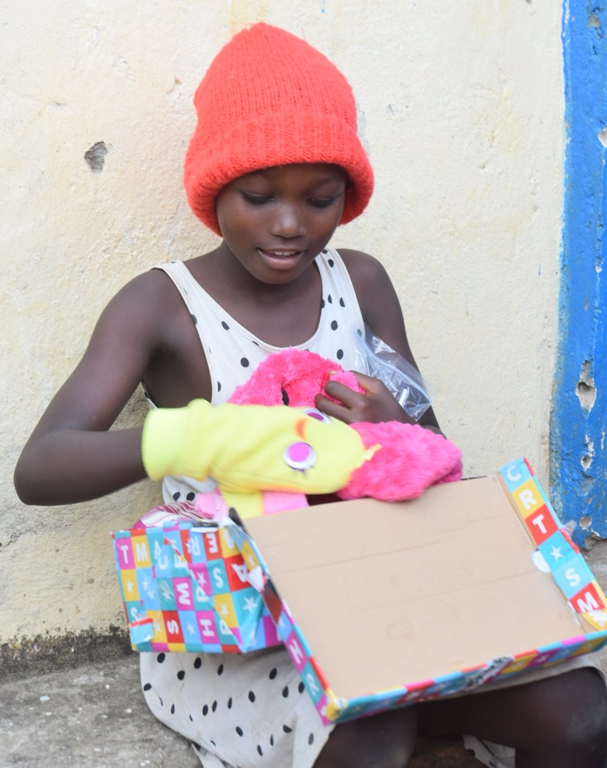
Aliona in Burundi
Aliona was delighted to get so many toys and copybooks!
“My parents will not struggle too much to get enough copybooks as they are too expensive!”
MAIN HEADING
GOES HERE

Slide 14
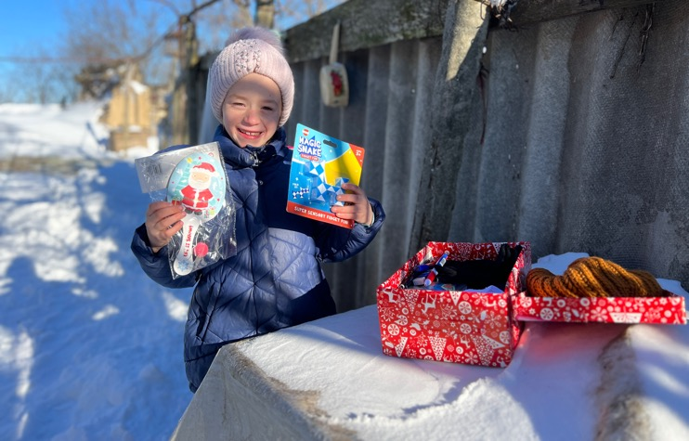
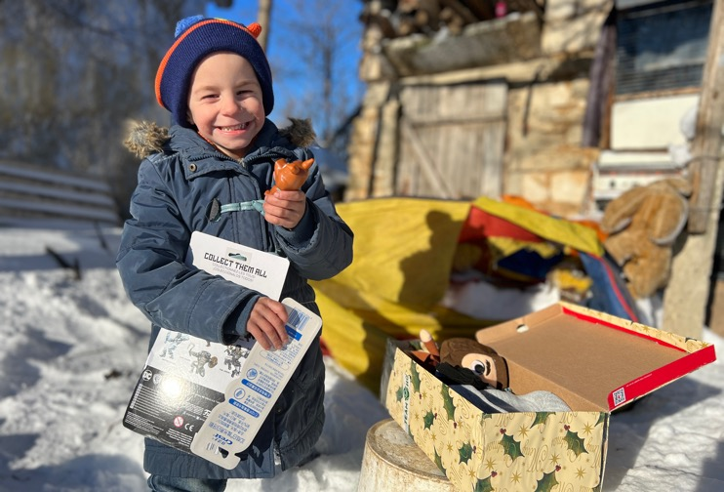
Afanasievka, Transnistria
This boy and girl are aged 7 and 4.
Their house is is small and has no heating and one of the rooms has no floor.
They adored their presidents, especially the toys, toothbrushes and toothpaste. They had never had new toys before!
They got firewood and food with their Shoeboxes too!
MAIN HEADING
GOES HERE

Slide 15
Your shoebox gift will be given into the hands of a child in need, irrespective of their race, religion, ethnicity or background. The only criteria for receiving a shoebox is the need of the child.
Thank you for making a difference !
MAIN HEADING
GOES HERE

